Slide 1
PandemicViz Sentiment Analysis on Twitter data
Sathyanarayanan Govindarajan & Mayur Rahangdale
Comp 529 Advanced Network
Professor : Senhua Yu

Slide 2
Index
Introduction
Objective
Significance
Data source
Technology
Twitter sentiment – Real Time visualization
Design and implementation
Historical Data Analysis.
Demo
Conclusion

Slide 3
Introduction
The goal is to build a real-time geographical mapping of COVID19 and their outbreaks, using Twitter data.
ELK (Elasticsearch, Logstash, Kibana) Stack is used for Data Ingestion, querying and visualization. An additional ML pipeline is proposed for Sentiment Analysis of target twitter data.
Sentiment analysis is used for event detection, opinion mining, and recommender system.

Slide 4

Objective
1
2
Developing a real-time system to predict the sentiment for coronavirus pandemic using Twitter streaming data
Collecting historical tweets data about coronavirus using #COVID-19 and #Coronavirus hashtags and do exploratory data analysis to identify correlation.

Slide 5

Significance
(1) Developing a real-time system to predict the sentiment for coronavirus pandemic using Twitter streaming data
Significance
Understanding knowledge gaps involves understanding the crisis event related questions posted by the public on social media.
Determination of the outbreak faster and helps to react to the situation.
Medical and public welfare preparation after earlier assessment of the outbreak.

Slide 6
Significance
(2) Collecting historical tweets data about coronavirus using #COVID-19 and #Coronavirus hashtags
Significance
Any correlation of the sentiments with the daily new cases and death rates?
Tweet sentiments?
Tweet volume, word cloud, demographic distribution, etc. ?

Slide 7
Significance
Historical
New Cases & Death
https://data.humdata.org/dataset/coronavirus-covid-19-casend-deaths
Twitter data
https://www.kaggle.com/gpreda/covid19-tweets
Real-time
Twitter API

Slide 8
Technology
Tweepy
Python library of Twitter API for fetching the tweets directly from Twitter
Textblob
Python library for text processing and it uses NLTK(Natural Language Toolkit) for natural language processing
Elastic Search for
Data Mapping
Requirement-based Querying
Data Visualization
Kibana Dashboard
Comparison b/w positive and negative tweets
Different kinds of Visualization
Python Libraries

Slide 9





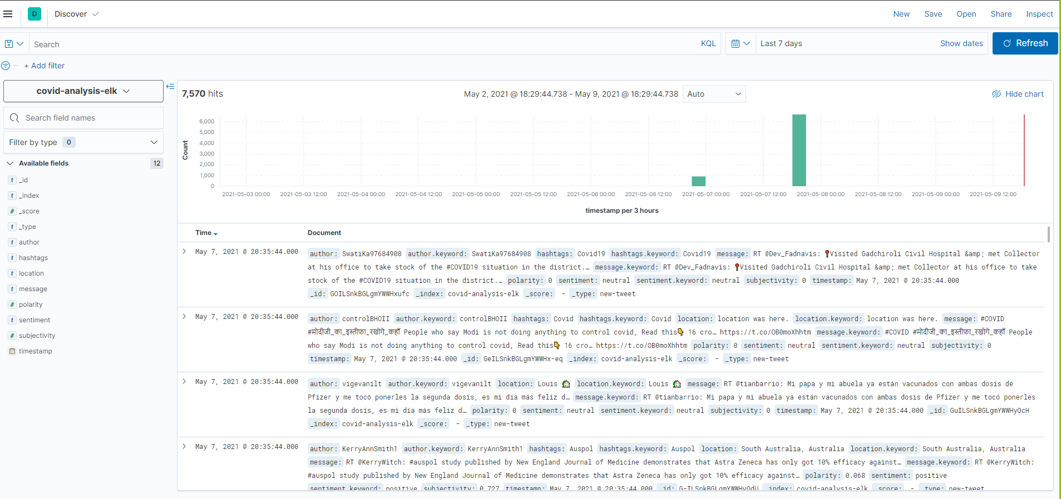
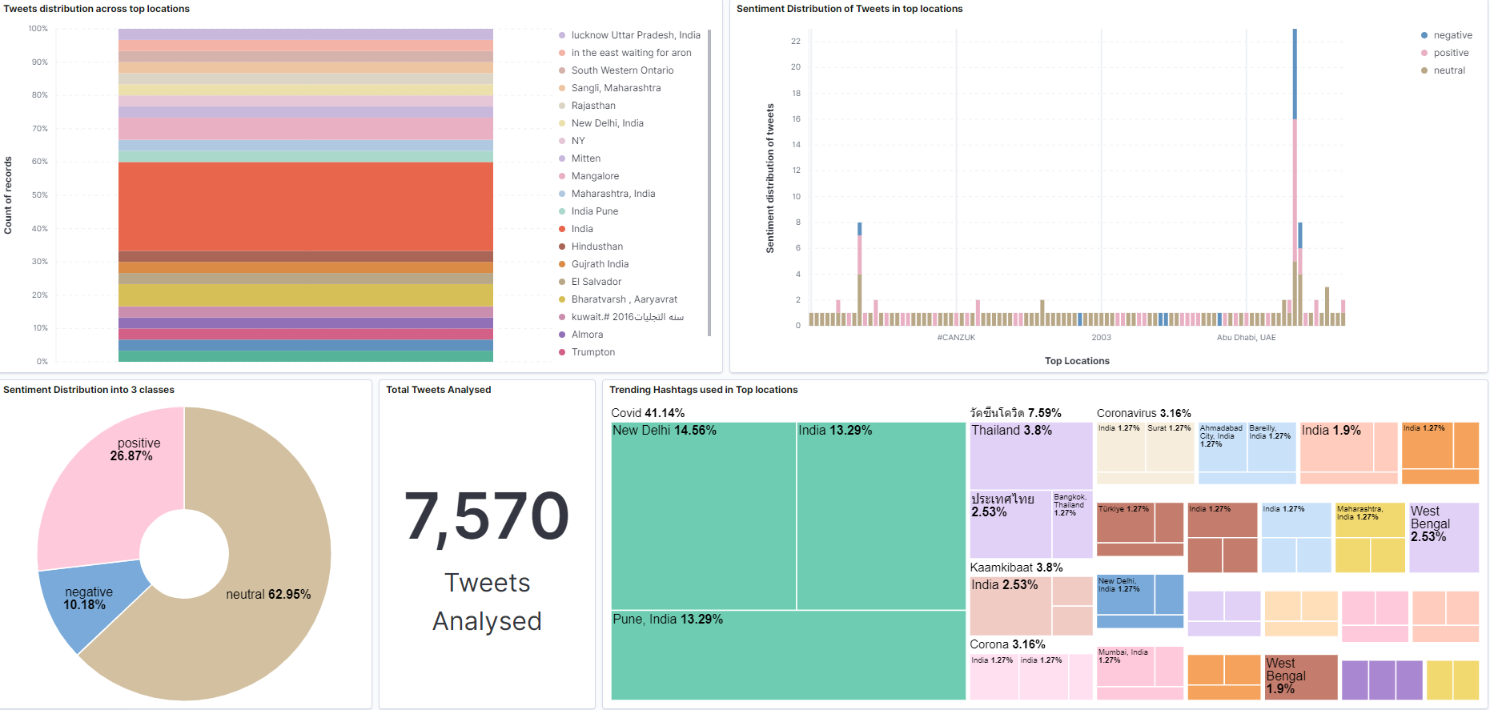
Twitter sentiment - Real-time Visualization
Real-time Twitter Data
Creating the connection with Twitter API
Sentiment analysis of the tweet message
Indexing for faster search and storage
Visualize
Twitter
Tweepy
Textblob
Elasticsearch
Kibana

Slide 10
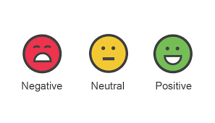
Textblob Sentiment Analysis
Textblob is an API for NLP tasks such as part-of-speech tagging, noun phrase extraction, sentiment analysis, classification, translation, and more.
TextBlob sentiment analysis processing employs two key metrics:
Polarity - score is a float within the range [-1.0, 1.0]
Subjectivity - score is a float within the range [0.0, 1.0]
1.0 – Positive Statement
-1.0 – Negative Statement
0.0 – Very Objective
1.0 – Very Subjective
Tweet-text
Textblob
*Polarity
*Subjectivity
**Sentiment
Note :
* Polarity and Subjectivity are Textblob direct output
** Sentiment is derived from polarity and subjectivity

Slide 11
Example
>>> TextBlob("So excited to get my vaccine!").sentiment Sentiment(polarity=0.46875, subjectivity=0.75)
Polarity is positive. Textblob recognizes a relatively positive emotional charge associated with the statement
Subjectivity- someone expressing how they feel, the statement is very subjective.
>>> TextBlob("Is the vaccine painful?").sentiment Sentiment(polarity=-0.7, subjectivity=0.9)
Polarity is negative - TextBlob recognizes a relatively negative emotional charge associated with the statement
Subjectivity- someone expressing how they feel, the statement is very subjective.
>>> TextBlob("The Pfizer vaccine is now FDA approved"),sentiment
Sentiment(polarity=0.0, subjectivity=0.0)
Polarity = 0.0 and Subjectivity is 0.0. The statement is identified as neutral in polarity and highly objective

Slide 12

Realtime Dashboard
Realtime Features
Tweet Count
Tweet Distribution at location level
Location wise Sentiment trend
Hashtag trends at location level
Tag cloud

Slide 13




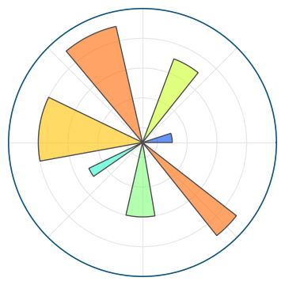
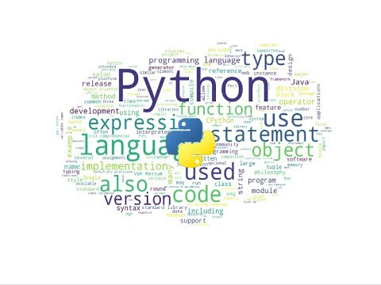
Twitter – Historical Data Analysis
Twitter
Historical Data
Exploratory Data Analysis
Twitter
Python

Slide 14
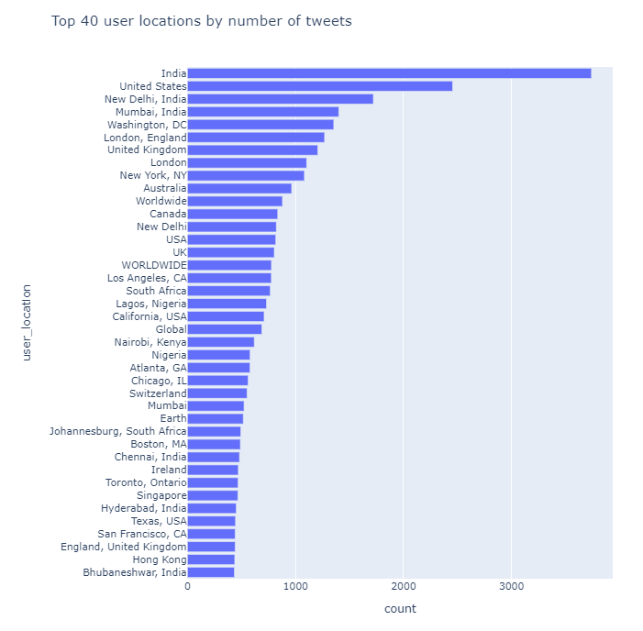
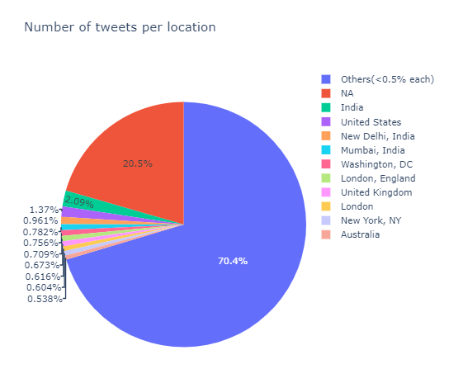
Historical Data Exploratory Analysis
Tweet percentage by location
Tweet counts of Top 40 user locations

Slide 15
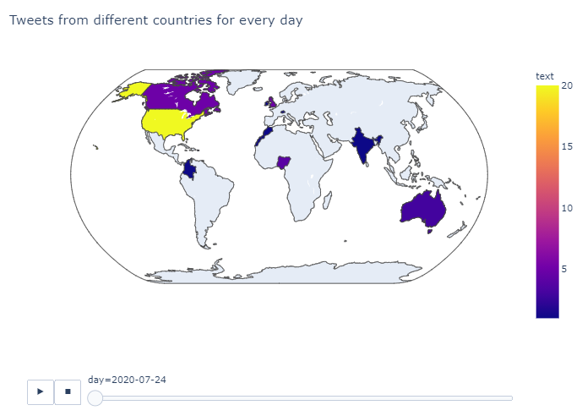
Historical Data Exploratory Analysis – Cont.
Tweet from different countries - interactive

Slide 16
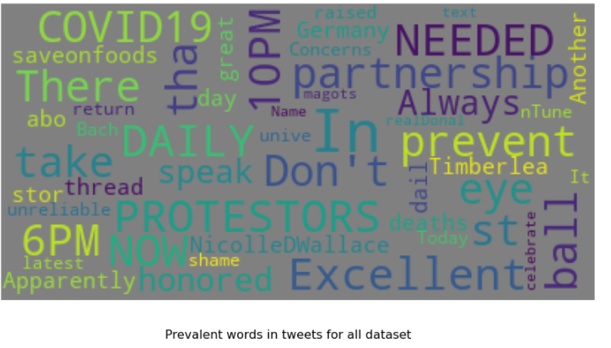
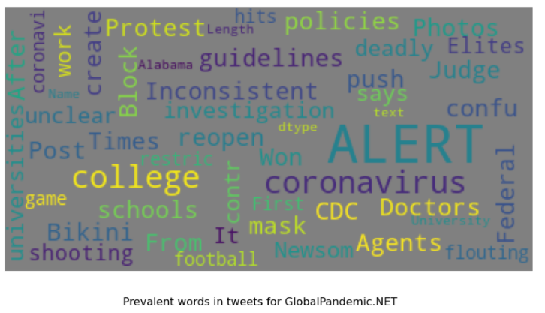
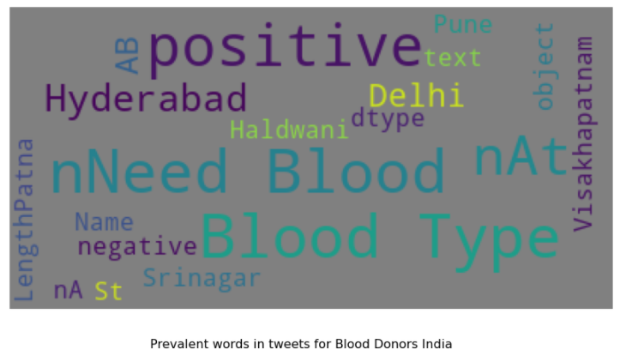
Historical Data Exploratory Analysis – Cont.
Prevalent words

Slide 17
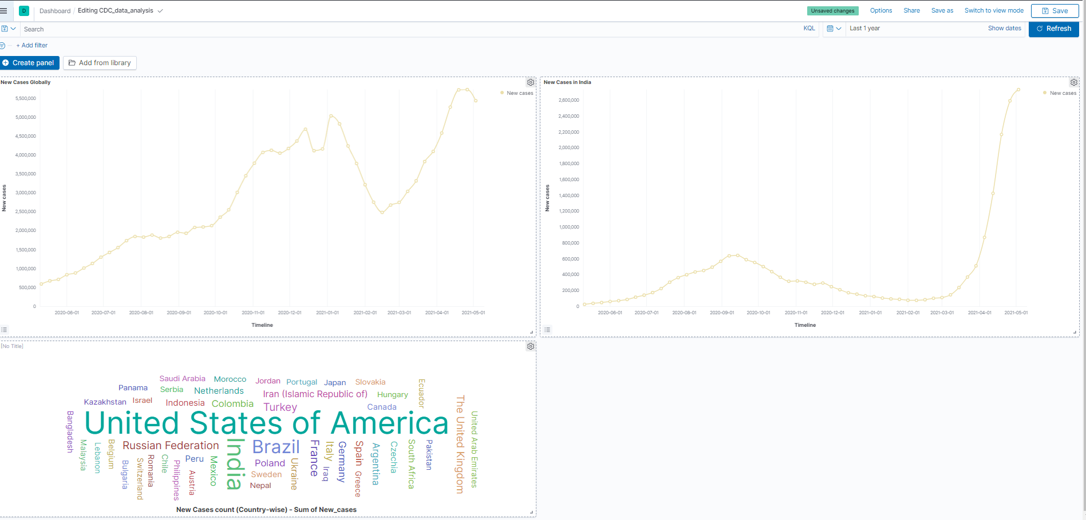
CDC data - Newcases

Slide 18
Demo

Slide 19
Conclusion
Real time Twitter analyzer provide insight of the location level discussion which helps to react the situation swiftly.
Visualization dashboard can give inference to address knowledge gaps, surveillance, prioritization and recognize the emergency needs of the people
Tools can be configured for other epidemic or pandemic diseases with small configuration change.

Slide 20
Thank you!

